Slide 1
Shoe Brand Sales Performance Analysis
Mirko Laine

Slide 2
Agenda
Introduction
Key Metrics
Brand Profitability and Costs
Revenue Development and Market Share
Dashboard

Slide 3
Introduction
This presentation provides a comprehensive overview of the sales, profitability and market shares of six well-known shoe brands.
The goal of the overview is to highlight business critical insights into brand performance across different time periods and sales channels using data.
The Analysis includes:
Sales revenue and profit
Sales volumes and average price
Market shares
Brand-specific costs and margins
Revenue development over time
Tools used:
Microsoft Excel
Pivot tables
Charts
Slicers
Visual Dashboard structure

Slide 4





Key Metrics
Total Revenue: 120 131 818 €
Units Sold: 2 477 947 pairs
The market demonstrates strong profitability, with more than half of the total revenue converting into profit.
This high profit margin indicates efficient cost management and a healthy business structure.
Meanwhile, the average price per pair remains moderate (45€), suggesting that the business model is driven by high sales volumes rather than premium pricing. This points to a strategy focused on scale and accessibility across multiple brands and distribution channel.
Average Price / pair: 45 €
Total Profit: 61 286 730 €
Profit Margin: 51,02%

Slide 5
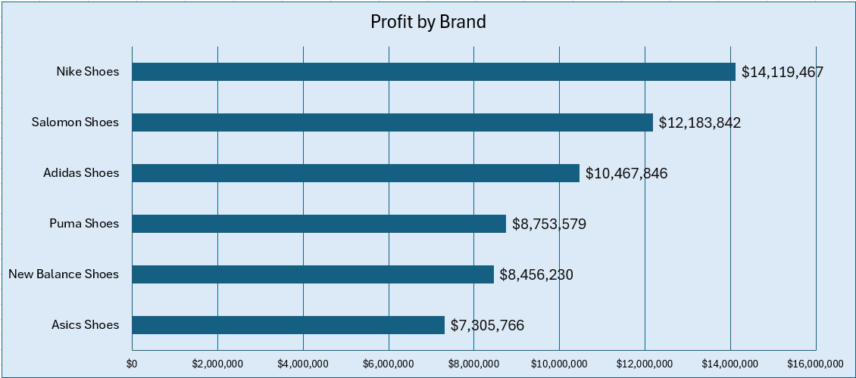
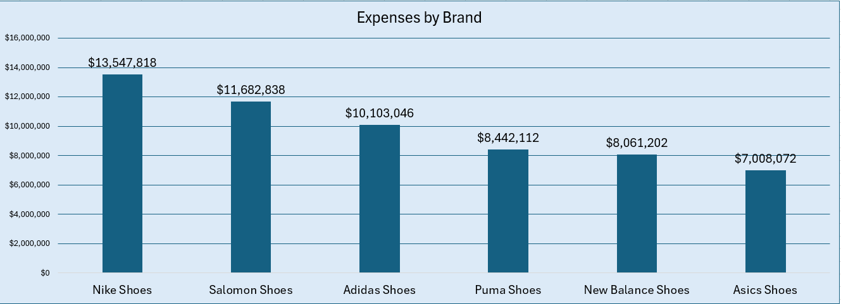
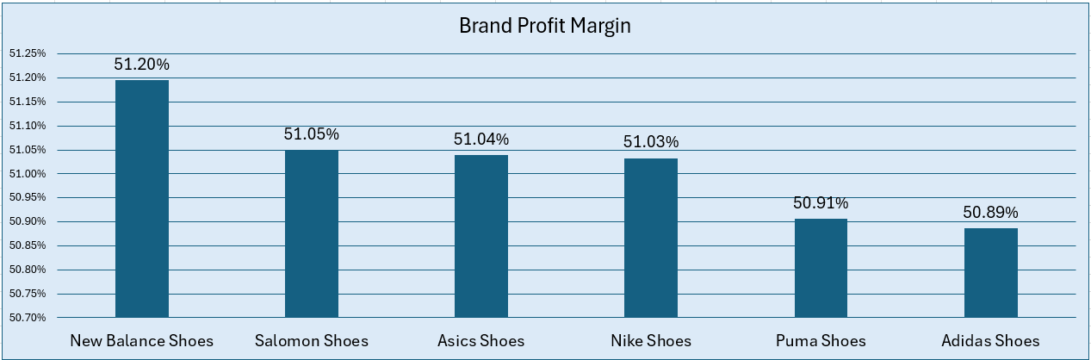
Brand Profitability and Costs – Who Generates the Highest Profits and at What Expense?
Nike emerges at the most profitable brand, achieving a total profit of 14.1 € million. While it also incurs the highest expenses at 13.5 € million, its ability to maintain a strong profit margin of 51.03% demonstrates operational efficiency and pricing power.
Salomon and Adidas also show robust profitability, each generating over 10 € million in profit. Their margins reflect a healthy balance between revenue and cost management, positioning them as strong competitors in the market.
Asics, on the other hand, reports lower absolute profits compared to the top brands. However, this is accompanied by significantly lower expenses, suggesting a leaner cost structure and potentially a more value-oriented market strategy.
These findings reveal how different brands adopt distinct business strategies. Some emphasizing scale and premium pricing, others focusing on cost control and efficiency

Slide 6
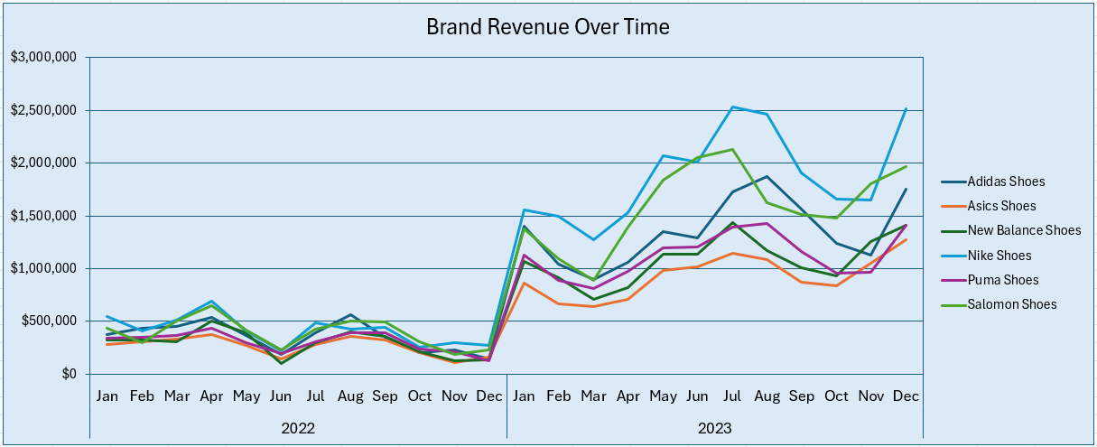
Revenue Development and Market Share
This slide show how each brand’s revenue evolved over time and how they positioned themselves in terms of market share.
Revenue Trends Over Time
The line chart illustrates brand-specific revenue progression from early 2022 thorough the end of 2023. Noticeable seasonal peaks are visible during major retail months like June, August and December, likely reflecting sales campaigns and holiday demand. Nike and Salomon show the strongest upward trends, especially in 2023, while smaller brands maintain steadier revenue lines.

Slide 7
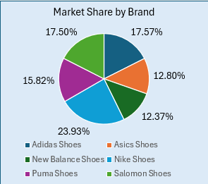
Market Share
This slide show how they positioned themselves in terms of market share.
Market Share Breakdown
The pie chart highlights the total market share distribution by brand.
Nike holds a commanding lead with approximately 24% of the total market.
Adidas, Puma and Salomon follow, each capturing over 15%, showing competitive strength.
Smaller players like Asics and New Balance maintain niche positions.
Insights:
Brands that combine strong seasonal revenue spikses with sustained year-round presence (like Nike and Adidas) are better positioned to capture and defend market share. This suggests success in both promotions and long-term customer loyalty.

Slide 8
Conclusion: Strategic Insights for Brand Portfolio Optimization
Key Takeaways:
High market profitability (51.02% margin) reflects strong cost control and volume-driven growth.
Nike leads in profit (€14.1M) and cost (€13.5M) — but maintains balance through efficient scaling and brand strength.
Revenue seasonality is evident, with spikes aligning to promotional months (e.g., June, December).
Market share concentration among top brands (Nike, Adidas, Salomon) indicates maturity but also margin pressure from competition.
Strategic Implications:
Double down on high-performing brands like Nike and Salomon — optimize pricing and campaign timing.
Monitor cost efficiency in leaner brands (e.g., Asics) — potential for margin improvement without large spend.
Leverage seasonal peaks with campaign playbooks, inventory readiness, and channel alignment.
Explore premium product strategies for brands with pricing power and scale.

Slide 9
Thank You!

